Slide 1
Flat minima generalize for low-rank matrix recovery
Yiran liu, Zhehao Shen, Shouchen Zhou
2024Spring

Slide 2
Flat minima: Problem we meet?
Powerful !!!
But!
overparameterized
Not generalizable
CNN
CNN
ReLU
ReLU
ReLU
CNN
CNN
···
CNN
DNN? Or other ML/AI method…

Slide 3
Flat minima: How to solve it?
After our survey, to enhance the model's generalizability, it is crucial to ensure that the model with properties of 'small norm' and 'flat landscape.

Slide 4
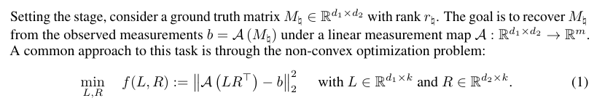
Flat minima: Problem modeling

Slide 5
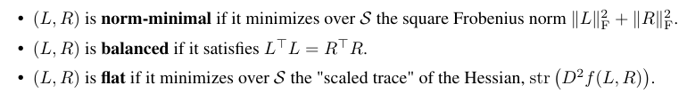
Flat minima: Important notion
The three properties are almost equivalent!
We can use norm-minimal constraint or balanced constraint to make model flat

Slide 6
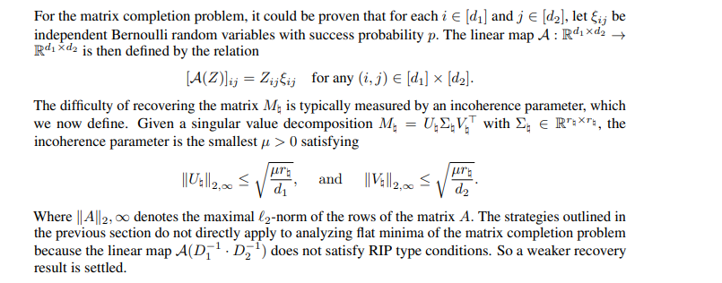
Flat minima: Some appliance
For Bernoulli random variable matrix

Slide 7
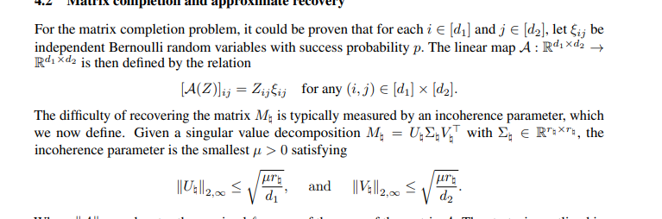
Flat minima: Some appliance
For Bernoulli random variable matrix

Slide 8
Thank you for watching!

